Slide 1

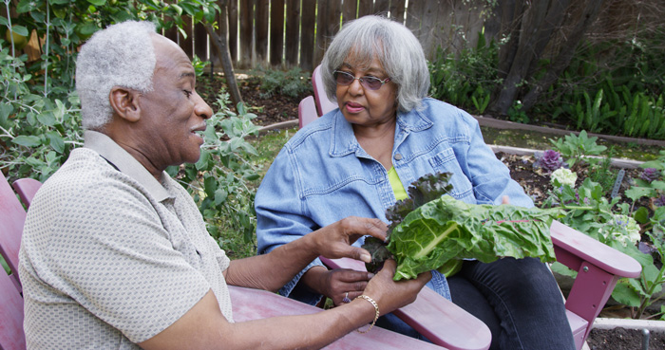




Evidence for Equality National Survey (EVENS)
DTNR Webinar: Exploring Social Inequalities through National Datasets
Nissa Finney (University of St Andrews)
2nd October 2024
Nissa.Finney@st-Andrews.ac.uk
@EthnicityUK
@EVENSurvey
www.ethnicity.ac.uk

Slide 2

what is EVENS?
EVENS is the largest and most comprehensive survey of ethnic and religious minorities in the UK.
EVENS has 14,000 participants including 10,000 who identify as ethnic minorities.
EVENS provides novel, robust data and is a unique, rich resource for understanding experiences of minoritised ethnic groups.
EVENS uses innovative non-probability survey methods to improve representation across ethnic groups.
DOCUMENTING THE LIVES
OF ETHNIC AND RELIGIOUS
MINORITIES IN A TIME
OF CRISIS

Slide 3
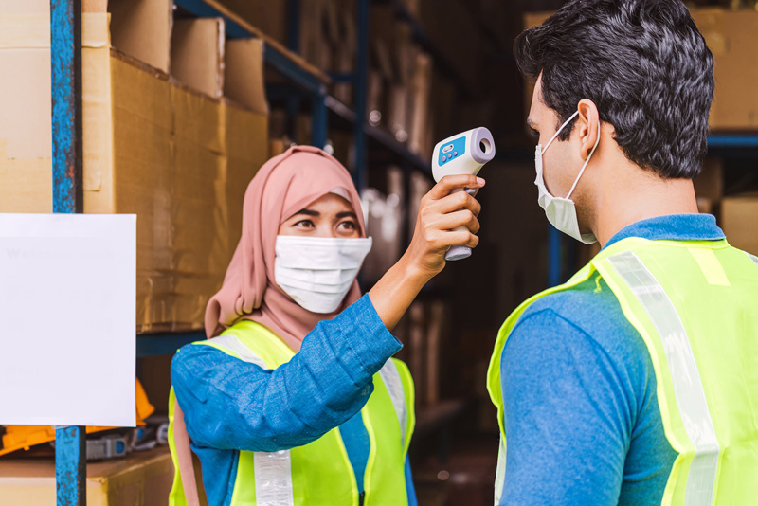
motivations for EVENS
DOCUMENTING THE LIVES
OF ETHNIC AND RELIGIOUS
MINORITIES IN A TIME
OF CRISIS

Slide 4


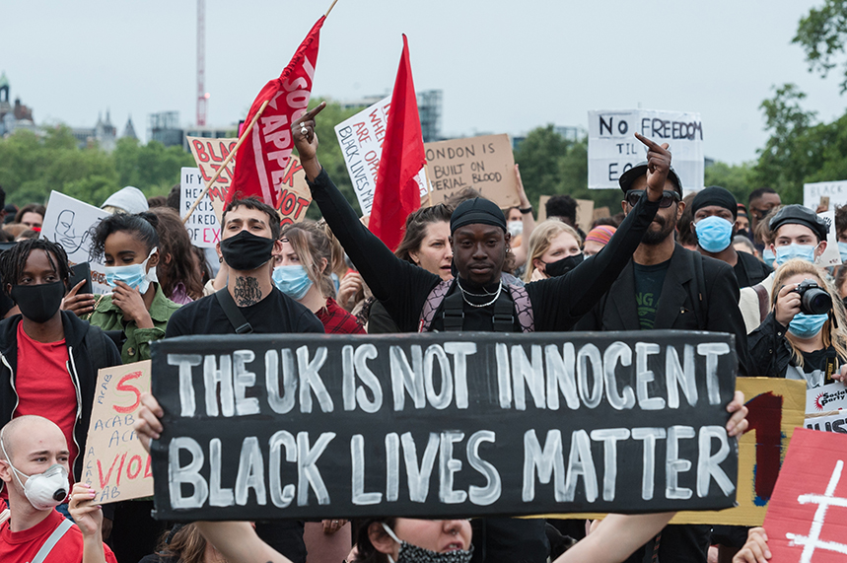
Why do we need a new survey?
a context of ethnic inequalities
Evidence shows stark and persistent ethnic inequalities in the UK over recent decades across social realms (Byrne et al 2020)
The pandemic emphasised ethnic inequalities (Lawrence 2020, ONS 2020, Katikireddi et al 2021, Nazroo and Becares (2020)

Slide 5
data deficiencies: the ‘ethnicity data gap’
Social surveys in the UK tend to represent a limited number of (broad) ethnic groups
Survey sampling favours (by design) areas of residential clustering of ethnic minorities
General surveys do not have questions bespoke to the concerns and experiences of minority groups
Census/administrative data have good population coverage but limited topic coverage
No prior application of rapidly developing non-probability survey methods to (numerically) small population in the UK
DOCUMENTING THE LIVES
OF ETHNIC AND RELIGIOUS
MINORITIES IN A TIME
OF CRISIS

Slide 6
recruitment and data collection
DOCUMENTING THE LIVES
OF ETHNIC AND RELIGIOUS
MINORITIES IN A TIME
OF CRISIS

Slide 7
overview
English
Arabic
Bengali
Chinese
Gujarati
Polish
Portuguese
Punjabi: Gurmukhi
Punjabi: Shahmukhi
Romanian
Somali
Turkish
Urdu
Welsh
Data collection from February to October 2021
30 minute questionnaire, developed with partners
Completed online via open web link or Telephone Interview (CATI), available in 14 languages
Non-probability, responsive recruitment design: all who consider themselves to be ethnic or religious minorities are invited to take part
Residency of England, Wales or Scotland required
£10 (voucher) issued upon completion of survey
Original questions & those developed from other surveys
Administered by Ipsos
Full ethical approval, University of Manchester
DOCUMENTING THE LIVES
OF ETHNIC AND RELIGIOUS
MINORITIES IN A TIME
OF CRISIS

Slide 8

recruitment partners
DOCUMENTING THE LIVES
OF ETHNIC AND RELIGIOUS
MINORITIES IN A TIME
OF CRISIS

Slide 9
the EVENS sample
DOCUMENTING THE LIVES
OF ETHNIC AND RELIGIOUS
MINORITIES IN A TIME
OF CRISIS

Slide 10
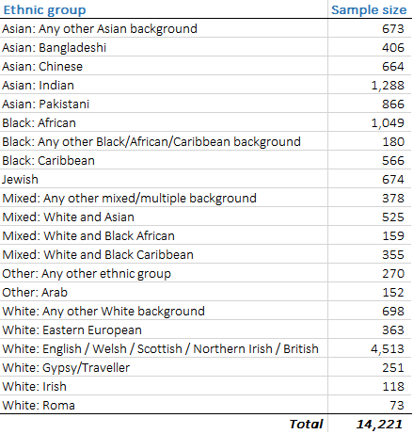
Larger sample sizes and more ethnic groups than any other UK social survey.
Motivations for EVENS
UNWEIGHTED SAMPLE SIZES
DOCUMENTING THE LIVES
OF ETHNIC AND RELIGIOUS
MINORITIES IN A TIME
OF CRISIS

Slide 11
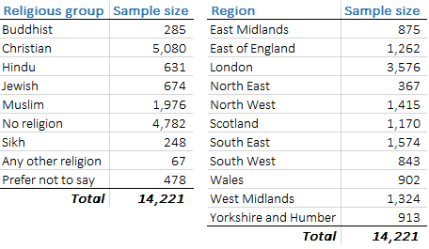
Motivations for EVENS
Age Group Sample Size
UNWEIGHTED SAMPLE SIZES
DOCUMENTING THE LIVES
OF ETHNIC AND RELIGIOUS
MINORITIES IN A TIME
OF CRISIS

Slide 12

data adjustments: weights
Weights have been created for the EVENS dataset. Applying the weights enables you to use the data as if it were representative of the GB population.
EVENS weights account for coverage errors and selection bias
  Adjustments for coverage error align the EVENS sample with the GB population in terms of key demographic characteristics: ethnic group, age (group), sex, region
  Adjustments for selection bias correct for the greater likelihood of some people (with particular characteristics) being more likely to take part in a/the survey
  Propensity score approach (quasi randomisation) is used that links EVENS participation to that from a reference probability sample (Baker et al 2013, Elliot and Valliant 2017), using responses to questions that are asked in the reference data and in EVENS
  Selection bias was adjusted on the basis of: voting eligibility, interest in politics, subjective general health, participation in religious events, religiosity, citizenship, trust in parliament, trust in the police
  Supporting data used: Censuses 2011 and 2021, Annual Population Survey, Ethpop estimates (2019), European Social Survey
DOCUMENTING THE LIVES
OF ETHNIC AND RELIGIOUS
MINORITIES IN A TIME
OF CRISIS

Slide 13
IT IS VITAL TO USE WEIGHTS WHEN USING EVENS DATA
Several weight variables are provided
For general use, we recommend: “weight2021propensity_pop”

Slide 14
about the data
DOCUMENTING THE LIVES
OF ETHNIC AND RELIGIOUS
MINORITIES IN A TIME
OF CRISIS

Slide 15
topics covered by EVENS
Socio-economic & financial circumstances
Ethnic/racial identity
Housing and demographics
Health and wellbeing
Black Lives Matter
Social cohesion and belonging
Attitudes towards the police
Covid-19 ‘compliance’
Trust in government (local/regional/national)
Racism and discrimination
DOCUMENTING THE LIVES
OF ETHNIC AND RELIGIOUS
MINORITIES IN A TIME
OF CRISIS

Slide 16
ethnic identity variables
Write in open response: “We are often asked to record our ethnicity. How would you describe your ethnic background in your own words?”
Ethnic group (Census 2021 categories)
Religion
Which types of synagogue are you currently a member of?
How important is your ethnic background/religion to your sense of who you are?
Wearing clothes/participating in activities/eating food “connected with your ethnicity or religion”
Country of birth
DOCUMENTING THE LIVES
OF ETHNIC AND RELIGIOUS
MINORITIES IN A TIME
OF CRISIS

Slide 17
racism and discrimination variables
Insulted “for reasons to do with your ethnicity, race, colour or religion”
Damage to property
Physical attack
Treated unfairly
  In education
  In your job
  Out in public
  By family or friends
  Housing
  In general
  Other
Neighbours “made life difficult for you or your family”
Worry about being harassed
Change in unfair treatment since the coronavirus outbreak
“How did you respond to these experiences of discrimination or unfair treatment?
  Tried to do something about it
  Accepted it as a fact of life
  Worked harder to prove them wrong
  Talked to someone
  Expressed anger
  Prayed
In the past year
Past 5 years
Last 10 years
Over 10 years ago
DOCUMENTING THE LIVES
OF ETHNIC AND RELIGIOUS
MINORITIES IN A TIME
OF CRISIS

Slide 18

Type of accommodation – including mobile
Access to sanitation and water services
Outdoor space
Home working & working arrangements during Covid-19
Financial circumstances and benefit receipt
Loneliness
Specific mental health conditions/feelings
Specific physical health conditions
Receipt of care
Experiences of Covid-19 virus
Household income
Immigration status
DOCUMENTING THE LIVES
OF ETHNIC AND RELIGIOUS
MINORITIES IN A TIME
OF CRISIS

Slide 19

EVENS findings: some highlights

Slide 20

The EVENS book (Finney et al 2023) illustrates the capabilities and key (descriptive) findings from EVENS
The book is available as a free ebook: www.ethnicity.co.uk
Note: the analyses in the book use V1 weights

Slide 21
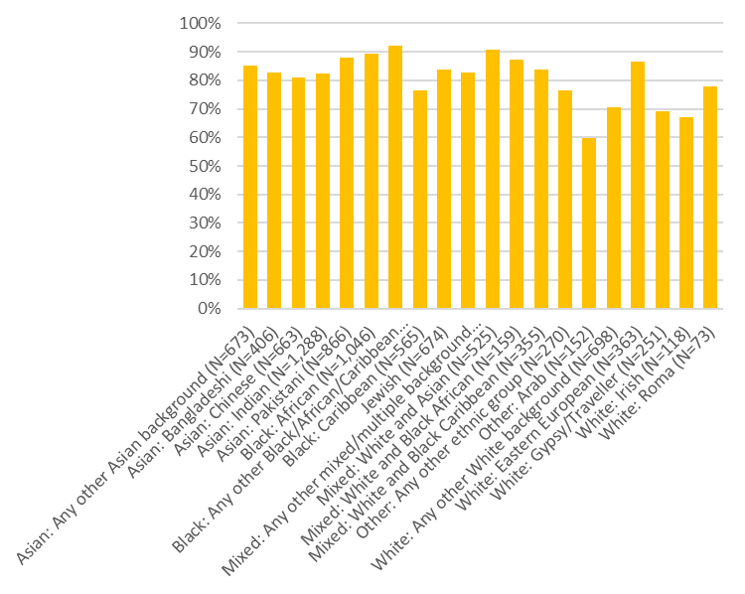
experiences of racism
80 %
of EVENS participants from minoritized ethnic groups have experienced some form of racial discrimination at some point in their life
(Becares et al, forthcoming)
DOCUMENTING THE LIVES
OF ETHNIC AND RELIGIOUS
MINORITIES IN A TIME
OF CRISIS

Slide 22
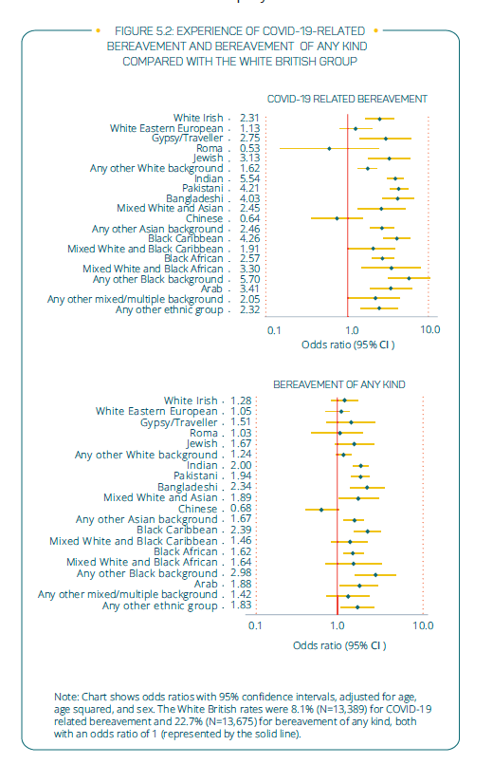
Ethnic minorities have a higher likelihood that the general (White British) population of having been recently bereaved, particularly in relation to Covid-19

Slide 23
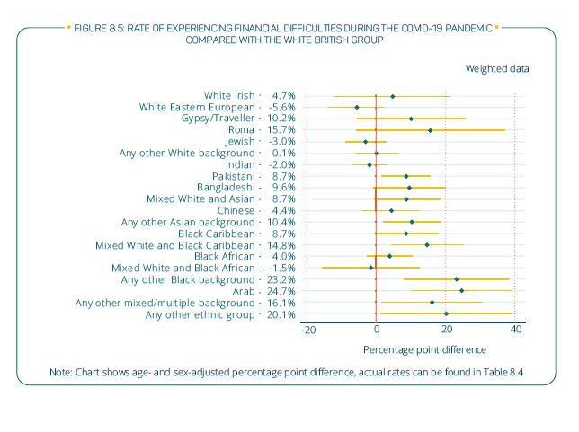
Ethnic minority groups have higher rates of experiencing financial difficulties (during the pandemic) than White British

Slide 24
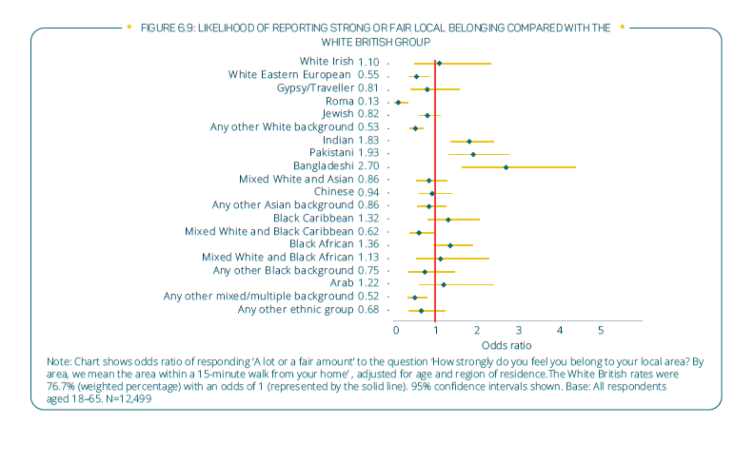
People identifying as Indian, Pakistani and Bangladeshi have notably strong sense of local (neighbourhood) belonging

Slide 25
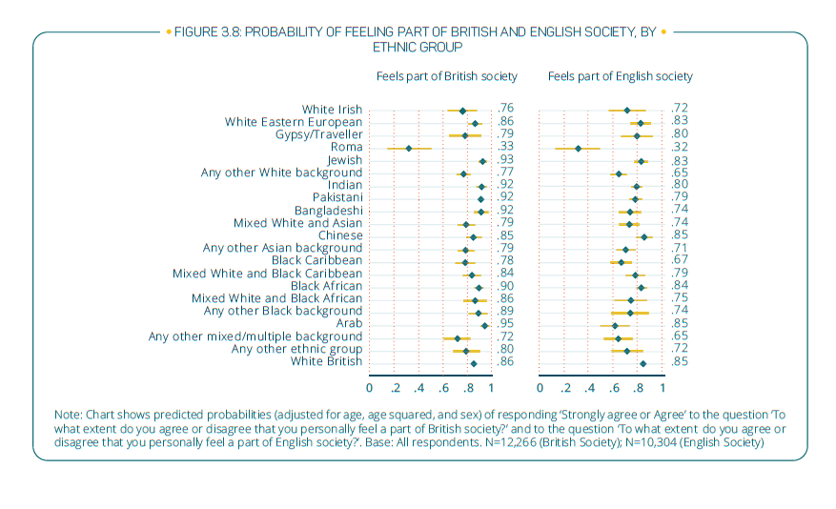
Most ethnic groups have very strong feelings of being part of British and English society

Slide 26
Current projects using EVENS
Lifecourse experiences of racism across ethnic groups in Britain
Connection between experiences of racism, ethnicity and loneliness
Protective effect of religion for loneliness during the pandemic
Prevalence of common mental disorders during the Covid-19 pandemic
Ethnicity and local neighbourhood belonging
Articulations of ethnic identity and lessons for official ethnic group categories
Political trust and compliance with Covid-19 measures
Flexible contracts and ethnic economic inequalities
Producing robust non-probability survey data
DOCUMENTING THE LIVES
OF ETHNIC AND RELIGIOUS
MINORITIES IN A TIME
OF CRISIS

Slide 27
accessing EVENS

Slide 28
Main dataset and Teaching dataset are freely available from the UK Data Service
SN: 9116 Evidence for Equality National Survey: a Survey of Ethnic Minorities During the COVID-19 Pandemic, 2021
Main dataset available under End User License (need to register to access data)
Teaching dataset available without registration
EVENS findings: some highlights

Slide 29

www.evensurvey.co.uk
@EVENSurvey #EVENSurvey
www.ethnicity.ac.uk
@EthnicityUK
DOCUMENTING THE LIVES
OF ETHNIC AND RELIGIOUS
MINORITIES IN A TIME
OF CRISIS

Slide 30
References
references
Baker, R.J., Brick, M., Bates, N.A., Battaglia, M., Couper, M.P., Dever, J.A., Gile, K.J and Tourangeau, R. (2013). Report of the AAPOR Task Force on Non-Probability Sampling. Available at: https://www.aapor.org/AAPOR_Main/media/MainSiteFiles/NPS_TF_Report_Final_7_revised_FNL_6_22_13.pdf
Becares, L., Taylor, H., Kapadia, D., Nazroo, J., Finney, N., Begum, N and Shlomo, N. (forthcoming 2024) The persistence and pervasiveness of racial discrimination in Great Britain: capturing experienced racial discrimination over time and life domains
Document Journal of Ethnic and Racial studies
Byrne, B., Alexander, C., Khan, O., Nazroo, J. and Shankley, W., (2020), Ethnicity and Race in the UK: State of the Nation. Policy Press, Bristol.
Elliot, M.R. and Valliant, R. (2017). Inference for Nonprobability Samples. Statistical Science 32(2): 249-264.
Finney, N., Nazroo, J., Becares, L., Kapadia, D. and Shlomo, N. (2023) Racism and ethnic inequality in a time of crisis: Findings from the Evidence for Equality National Survey Bristol: Policy Press
Finney, N., Nazroo, J., Shlomo, N., Kapadia, D., Becares, L., Byrne, B. (2024). Evidence for Equality National Survey: a Survey of Ethnic Minorities During the COVID-19 Pandemic, 2021. [data collection]. UK Data Service. SN: 9116, DOI: http://doi.org/10.5255/UKDA-SN-9116-1
Katikireddi SV, Lal S, Carrol ED, et al Unequal impact of the COVID-19 crisis on minority ethnic groups: a framework for understanding and addressing inequalities J Epidemiol Community Health 2021;75:970-974.
Lawrence, D. (2020), ‘An Avoidable Crisis: The disproportionate impact of Covid-19 on Black, Asian and minority ethnic communities’, The Doreen Lawrence Review. Available at: https://uploads-ssl.webflow.com/5f5bdc0f30fe4b120448a029/5f973b076be4cadc5045fad3_An%20Avoidable%20Crisis.pdf
Nazroo, James and Bécares, Laia (2020) Evidence for ethnic inequalities in mortality related to COVID-19 infections: findings from an ecological analysis of England. BMJ Open, 10 (12). a041750 1-6. ISSN 2044-6055
ONS (2020) https://www.ons.gov.uk/peoplepopulationandcommunity/healthandsocialcare/conditionsanddiseases/articles/whyhaveblackandsouthasianpeoplebeenhithardestbycovid19/2020-12-14
Schouten, B. and Shlomo, N. (2017). Selecting Adaptive Survey Design Strata with Partial R-indicators. International Statistical Review 85(1): e 1, 143-163.
Schouten, J.G., Cobben, F., Bethlehem, J. (2009). Indicators for the Representativeness of Survey Response, Survey Methodology 35(1): 101 – 113.
DOCUMENTING THE LIVES
OF ETHNIC AND RELIGIOUS
MINORITIES IN A TIME
OF CRISIS

